Slide 1
RISC-V
Pipeline Core

Slide 2
Overview
Implementation of Fetch Cycle
Implementation of Decode Cycle
Implementation of Execute Cycle
Implementation of Memory Cycle
Implementation of Write Back Cycle
Implementation of Pipeline Top
Pipeline Hazards
Implementation of Hazard Unit
Implementation of Pipeline Top II

Slide 3
Overview of RISC-V Pipeline Architecture

Slide 4
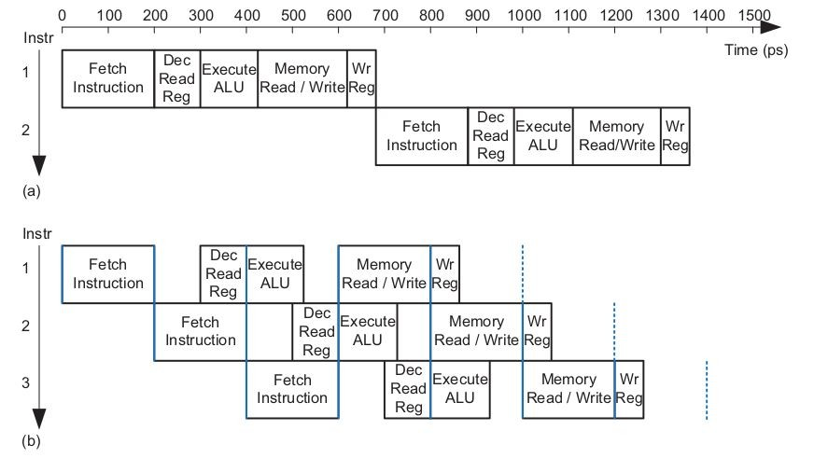
Pipelining
We design a pipelined processor by subdividing the single-cycle processor into five pipeline stages.
Thus, five instructions can execute simultaneously, one in each stage. Because each stage has only one-fifth of the entire logic, the clock frequency is approximately five times faster.

Slide 5

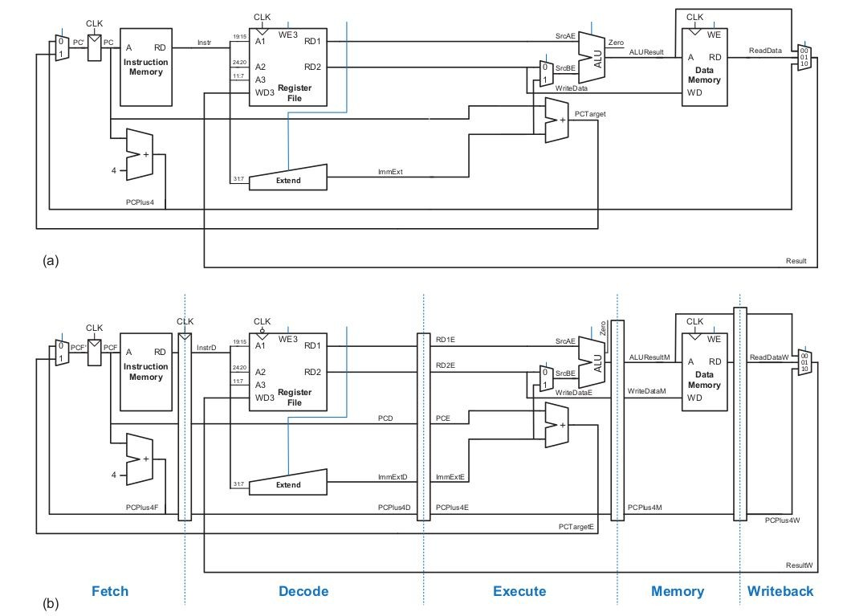
Pipelining

Slide 6
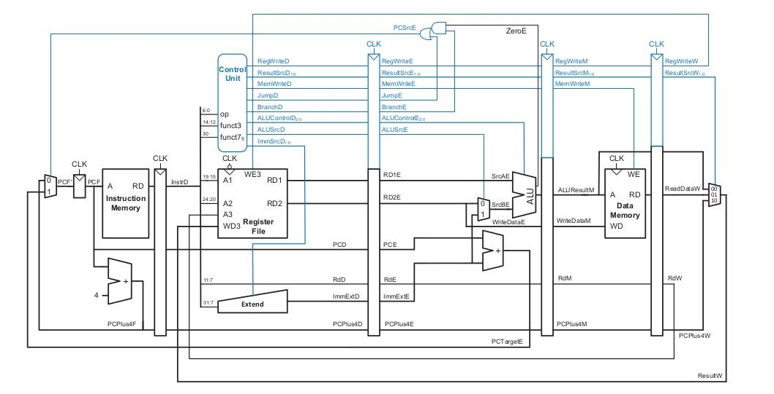
Pipeline Datapath

Slide 7
Implementation of Fetch Cycle

Slide 8
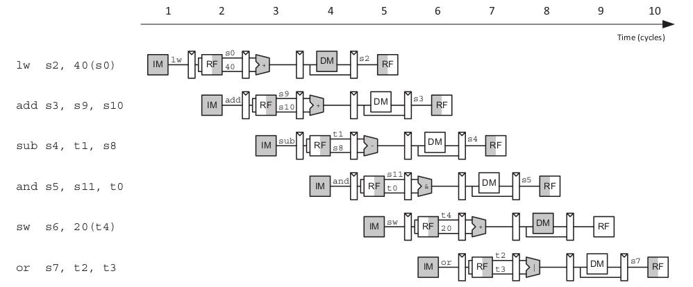
Abstract View of Pipelining

Slide 9
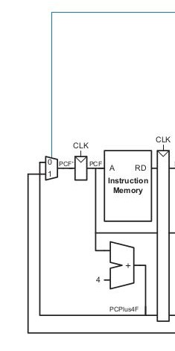
Fetch Cycle Datapath
PCSrcE
Modules to be Integrated:
PC Mux
Program Counter
Adder
Instruction Memory
Fetch Stage Registers
InstrD
PCD
PCPlus4D
PCTargetE

Slide 10
Implementation of Decode Cycle

Slide 11
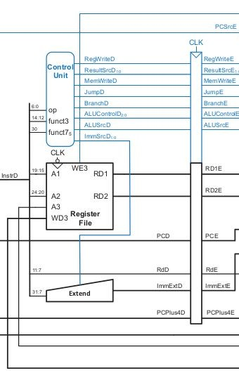
Decode Cycle Datapath
RegWriteW
X
Modules to be Integrated:
Control Unit
Register File
Extender
Decode Stage Registers
InstrD
PCD
PCPlus4D
X RDW
ResultW

Slide 12
Implementation of Execute Cycle

Slide 13
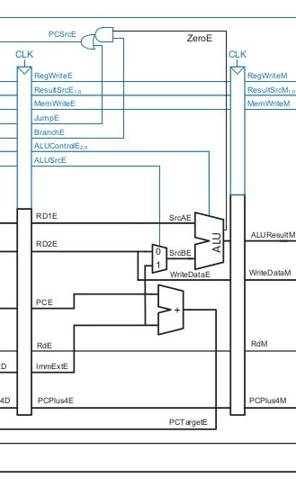
Execute Cycle Datapath
X
Modules to be Integrated:
AND Gate
Mux
Adder
ALU
Execute Stage Registers
X
X

Slide 14
Implementation of Memory Cycle

Slide 15
Pipeline Datapath

Slide 16
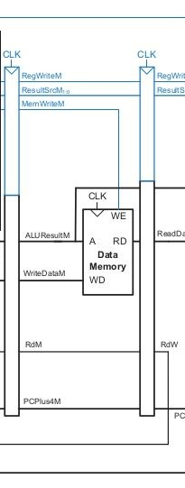
Memory Cycle Datapath
X
Modules to be Integrated:
Data Memory
Memory Stage Registers
X
X

Slide 17
Implementation of Write Bacfi Cycle

Slide 18
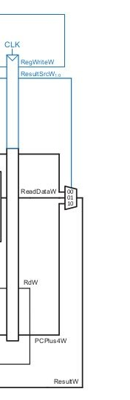
Write Bacfi Cycle Datapath
Modules to be Integrated:
1) Mux

Slide 19
Implementation of Pipeline Top

Slide 20
Pipeline Datapath

Slide 21
Pipeline Hazards

Slide 22
Pipeline Hazard
Structural Hazard
Hardware does not support the execution of instruction in same clock cycle.
Without having Two memories RISC-V pipelining architecture will have structural hazard.
Data Hazard
Data to be executed is not available.
May occur when pipeline is stalled.
Solve by using forwarding or bypassing technique.

Slide 23
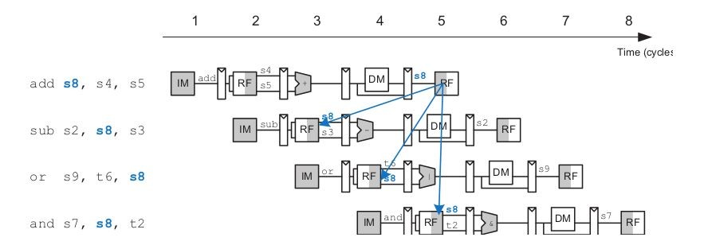
Data Hazard In Pipelining

Slide 24
Solution of Data Hazards
Solving Data Hazards with nops
Solving Data Hazard with Forwarding / Bypassing

Slide 25
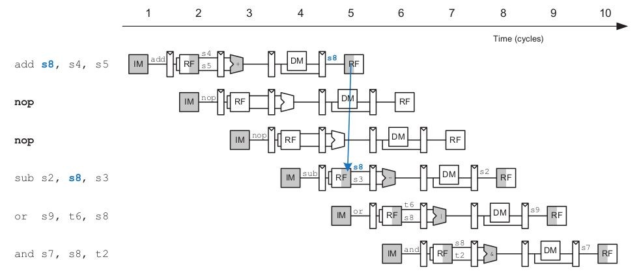
Using Nops

Slide 26
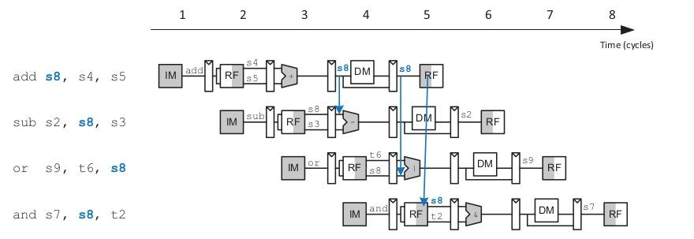
Using Forwarding / Bypassing

Slide 27
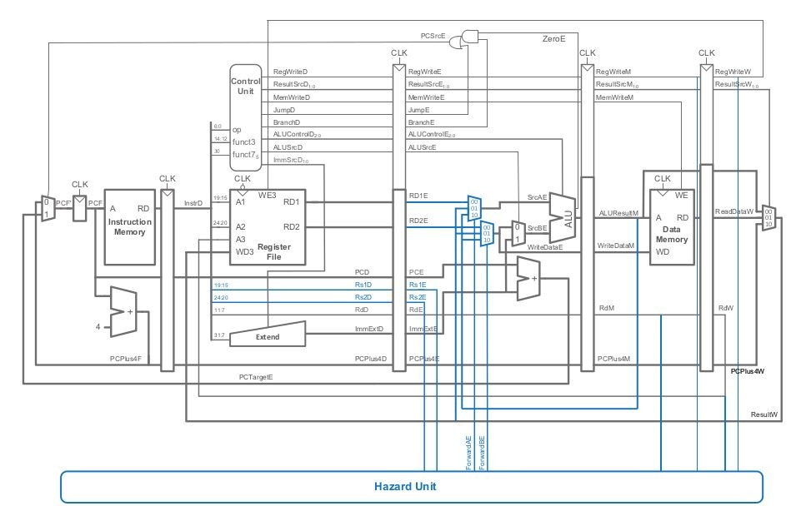
Updated Pipeline Top Architecture

Slide 28
Implementation of Hazard Unit

Slide 29
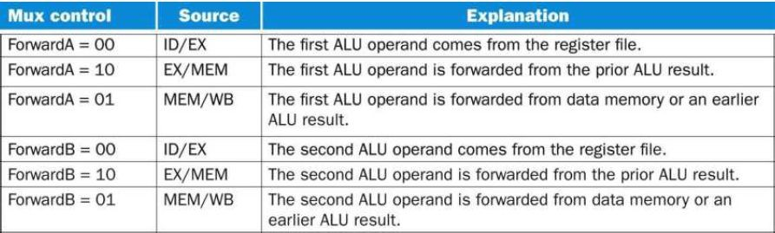
Condition Table

Slide 30

Condition for Data Hazard
Memory Stage
if (RegWriteM and (RdM != 0) and (RdM == Rs1E))
ForwardAE = 10
if (RegWriteM and (RdM != 0) and (RdM == Rs2E)) ForwardBE = 10
WriteBack Stage
if (RegWriteW and (RdW != 0) and (RdW == Rs1E))
ForwardAE = 01
if (RegWriteW and (RdW != 0) and (RdW == Rs2E)) ForwardBE = 01
ForwardAE ForwardBE
RegWriteM
RdW RegWriteW
Rs2E Rs1E
RdM

Slide 31
Implementation of Pipeline Top II

Slide 32
Updated Pipeline Top Architecture

Slide 33
Thank You

